Slide 1
St Andrew’s Preachers PowerPoint Template
This template has been designed for Preachers to ensure compatibility with the rest of the systems used.
When adding or pasting in slides always choose the “Use Destination Theme (H)” option; never the “Keep Source Formatting (K)” option as this changes the underlying template and can cause problems.
When adding a new slide go to ‘Insert’ & then ‘New Slides’ to select the template that you want to use for the new slide.
The absolute minimum text size is 24 point Arial (ideally with Bold and Shadow enabled) in a good contrast for text to be visible from back of church.
The projection system in church in daylight means that the contrast will not be as good as viewed on your computer screen. Also avoid using borders as these can distort.
We use a 1024 x 768 display and any full screen images should be as close to this as possible for clarity.
Slides such as the welcome, hands and title slides are there purely as examples.

Slide 2
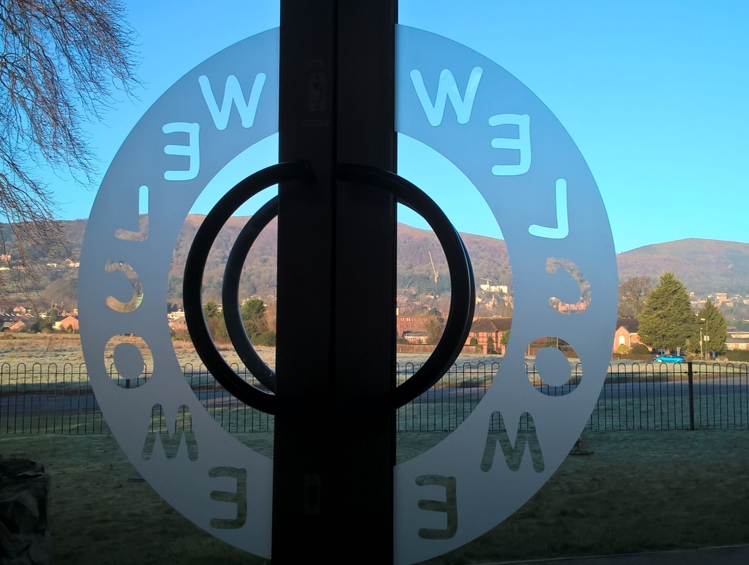

Slide 3
Blank Title Slide
Subtitles

Slide 4
Blank Title & Content Slide
Points
Points

Slide 5
Blank Slide

Slide 6
Normal Blank Slide on Blue Background

Slide 7
Blank Slide on a White Template

Slide 8
Blank slide on a Black Template

